Slide 1
Music Analysis Project
Caiyi Zhao

Slide 2
Agenda
Logic to Get Each Column (SQL, Python)
Data Statistical Summary
Visualization & Insights
Recommendations

Slide 3



Logic Behind Each Column (SQL)
“SELECT” , “FROM”
(playlist_id, genre_name, streams)
“LEFT JOIN”
“COUNT AS” , “SUM”
(playlist_num_songs, umg_share)
“CASE” (popularity)

Slide 4


Logic Behind Each Column (Python)
Merge Dataframes
Groupby, Value_Counts
Calculated Column, Lambda Apply

Slide 5

Data Statistical Summary
60 Hot playlists: 30,221 times of play, 0.5% owned by UM.
Number of countries as the origin of playlists: 28
Total number of songs: 3,296,341
Total number of songs owned by UM: 31,002
Share owned by UM: 0.9%

Slide 6
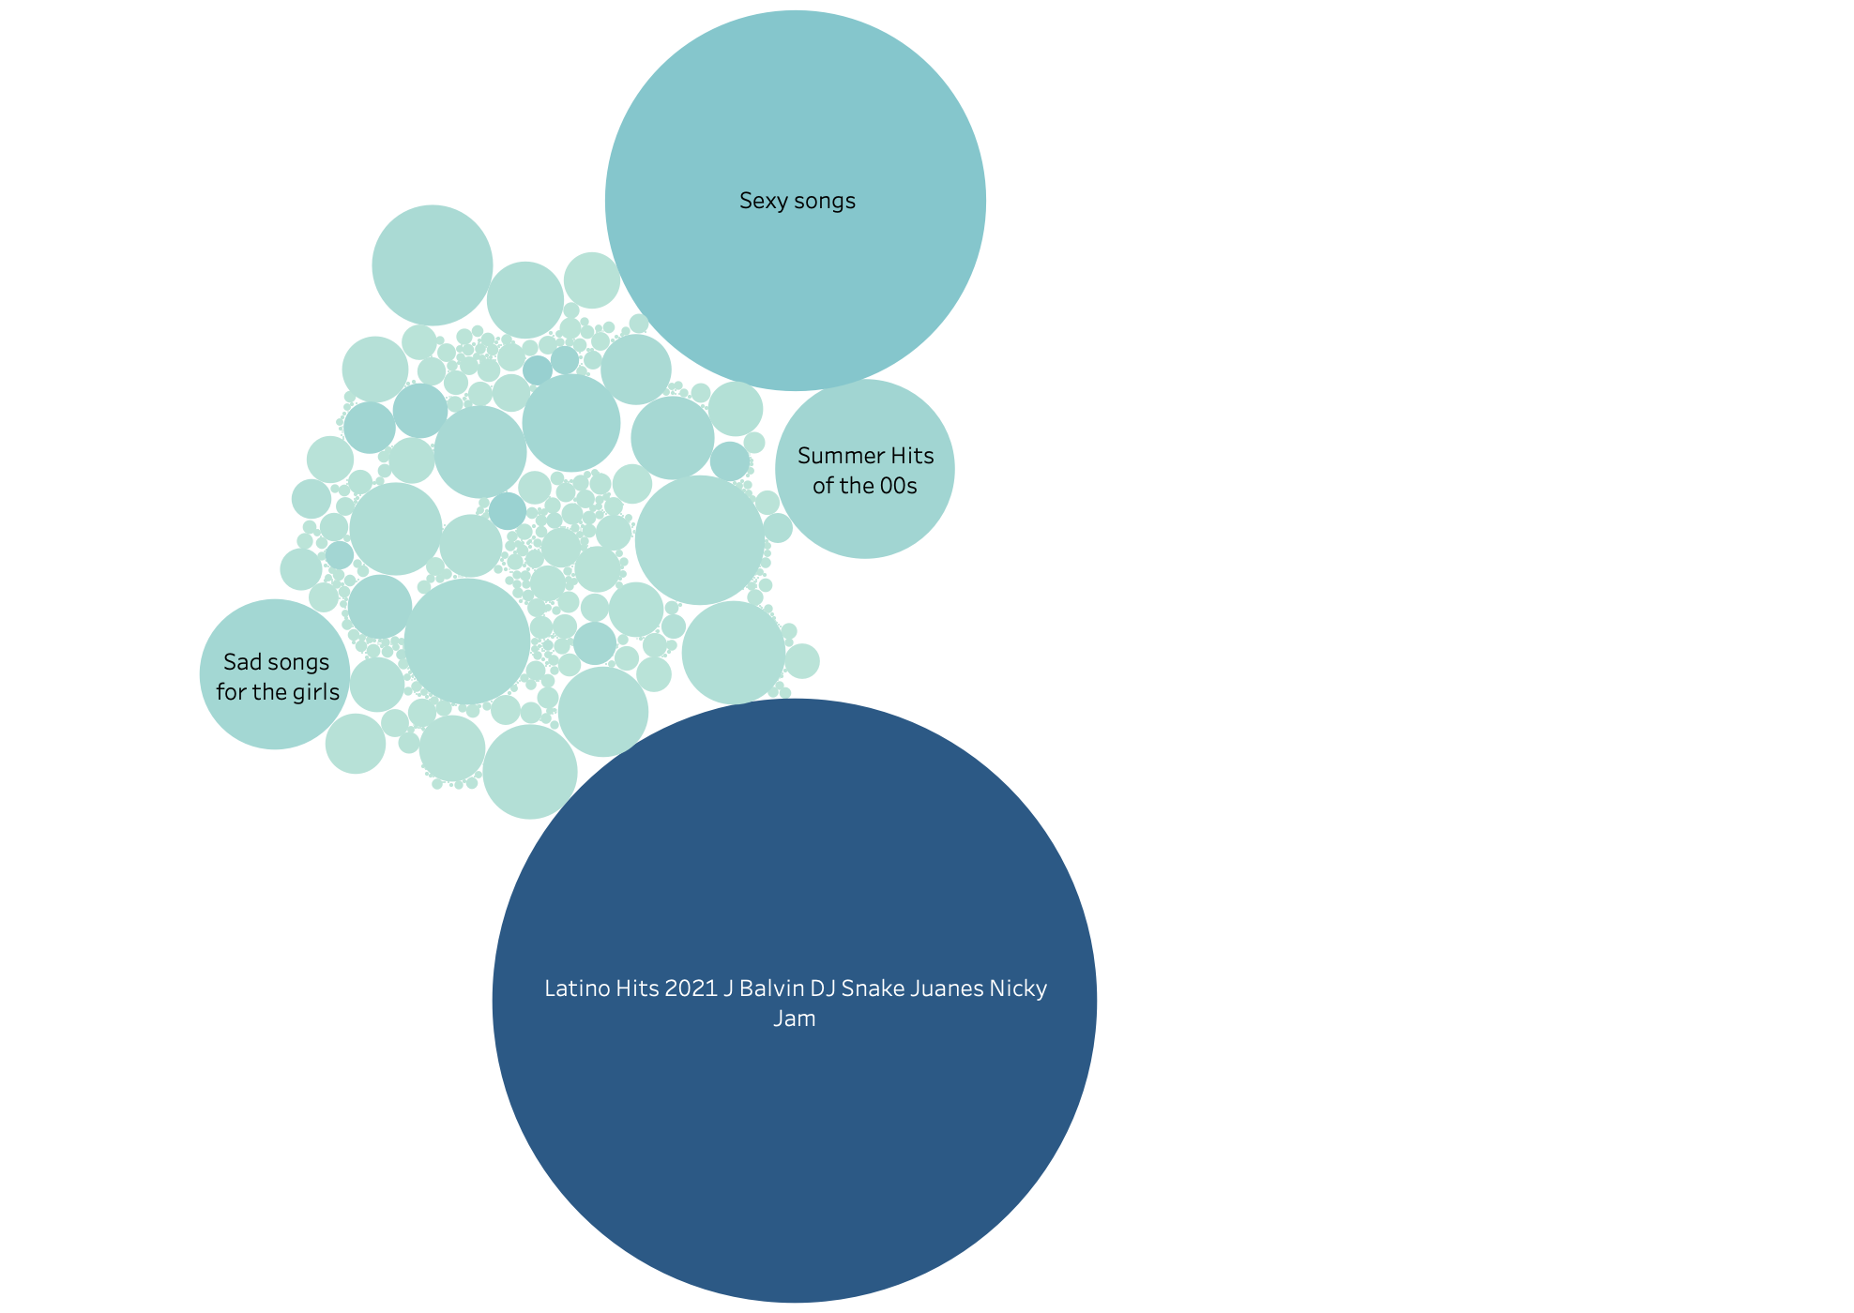
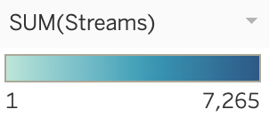
Trending Playlist Names
Size: number of songs
Color: number of streams
Float: share of UM
0.3
0.5
0.7
0.2

Slide 7
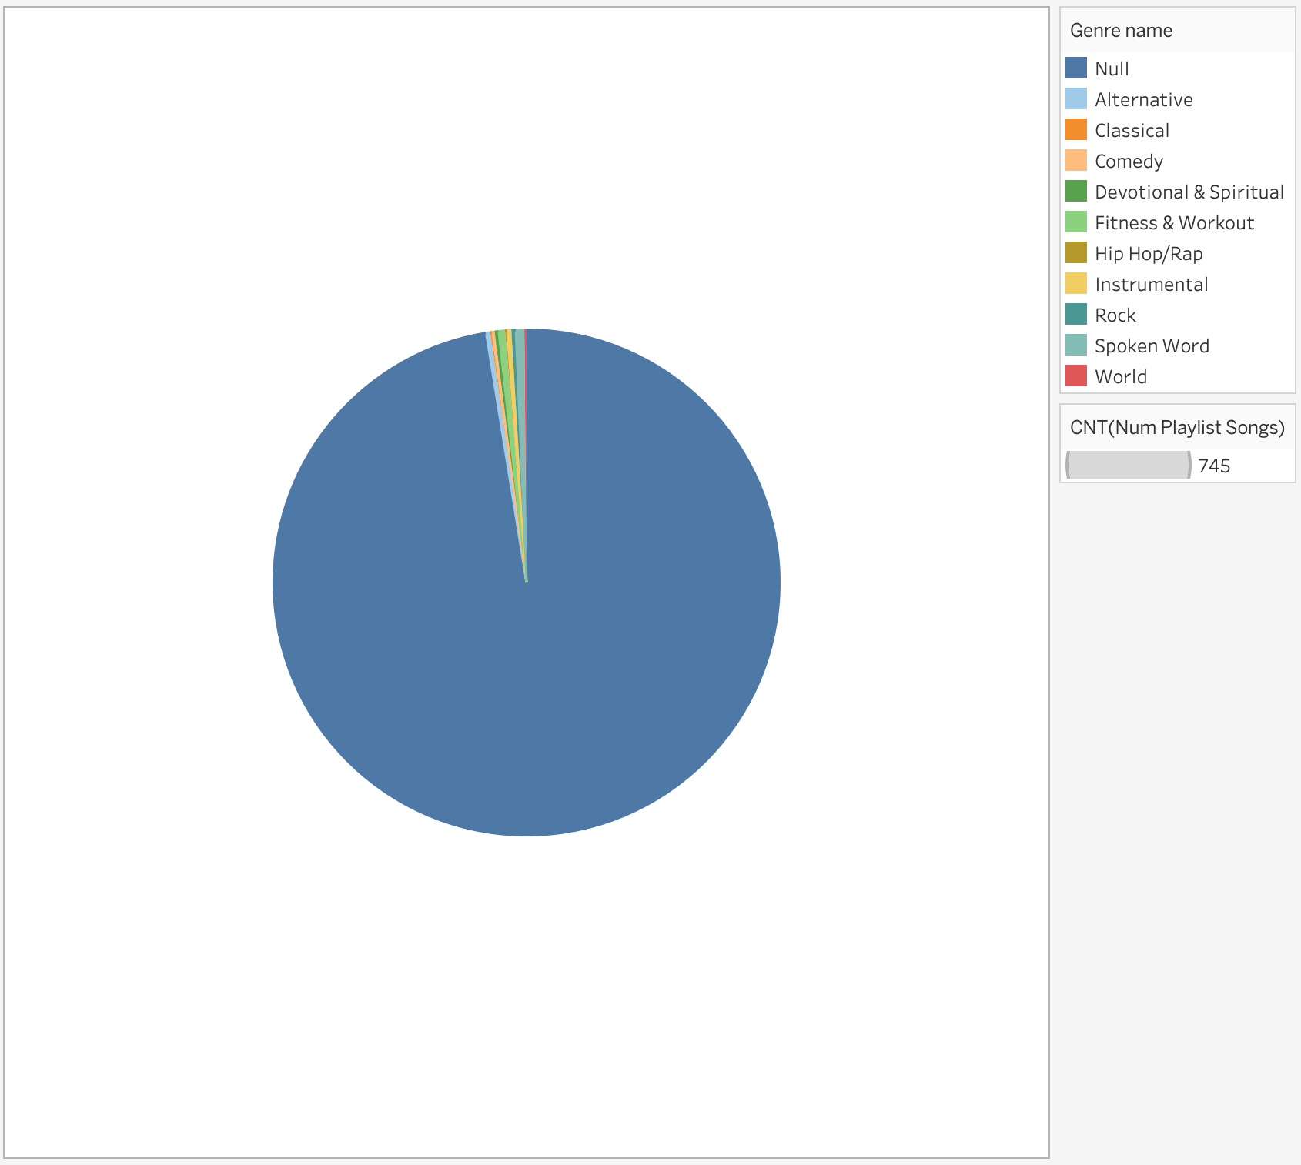
Songs Genre
Most of the songs in playlists do not have a matching genre.
10 different genres.

Slide 8
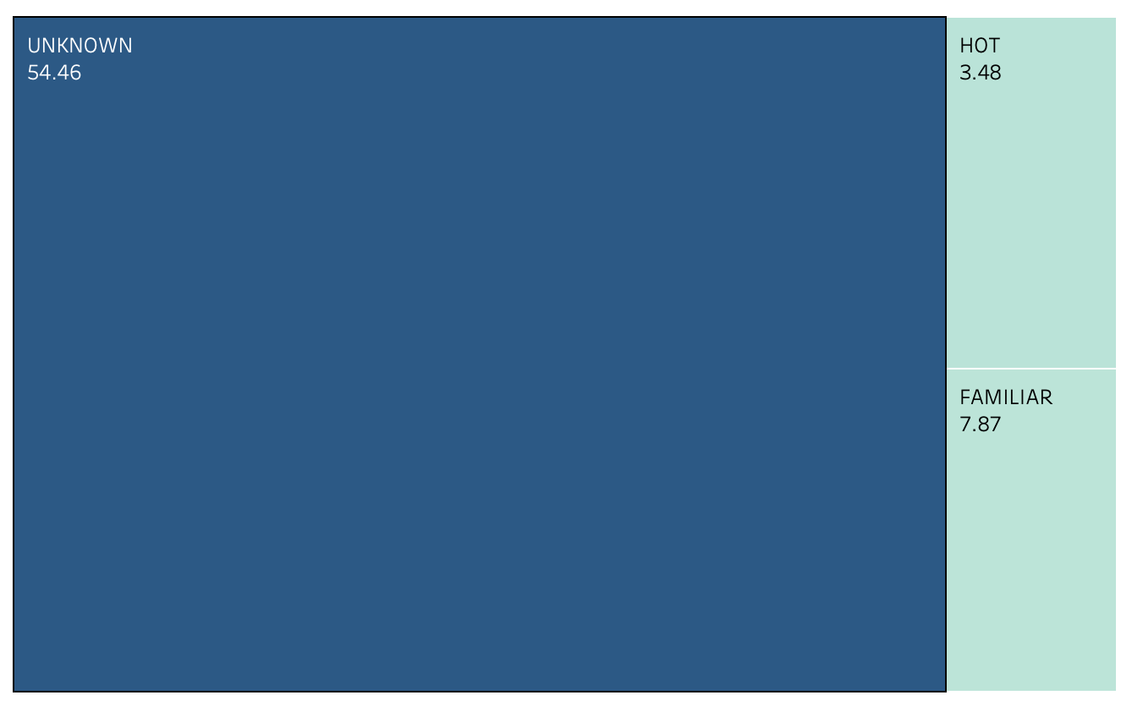
Playlist Popularity
Most of the playlists are “UNKNOWN”
UM owns 3.48% of the HOT songs.

Slide 9
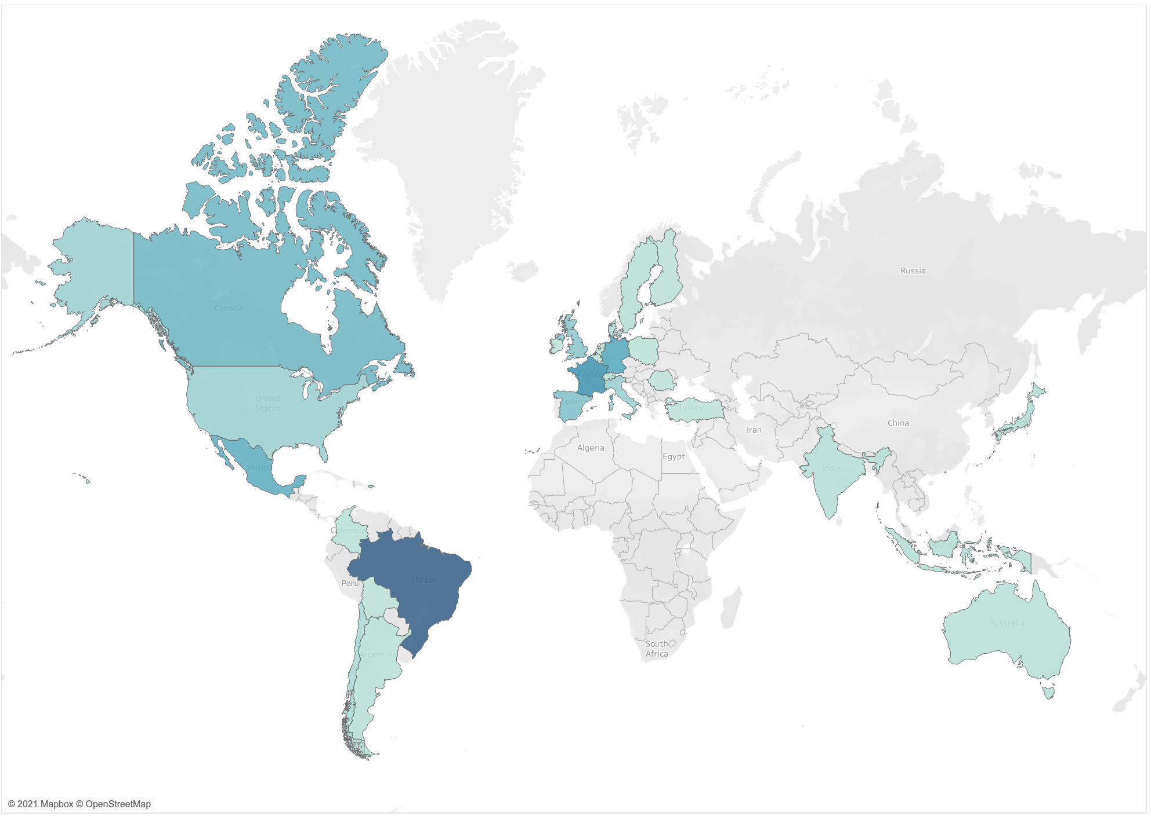
Dark Bright:
Streams Number Decreases
Sweden
Finland
Canada
France
United States
Japan
Mexico
India
Colombia
Brazil
Australia
Argentina

Slide 10
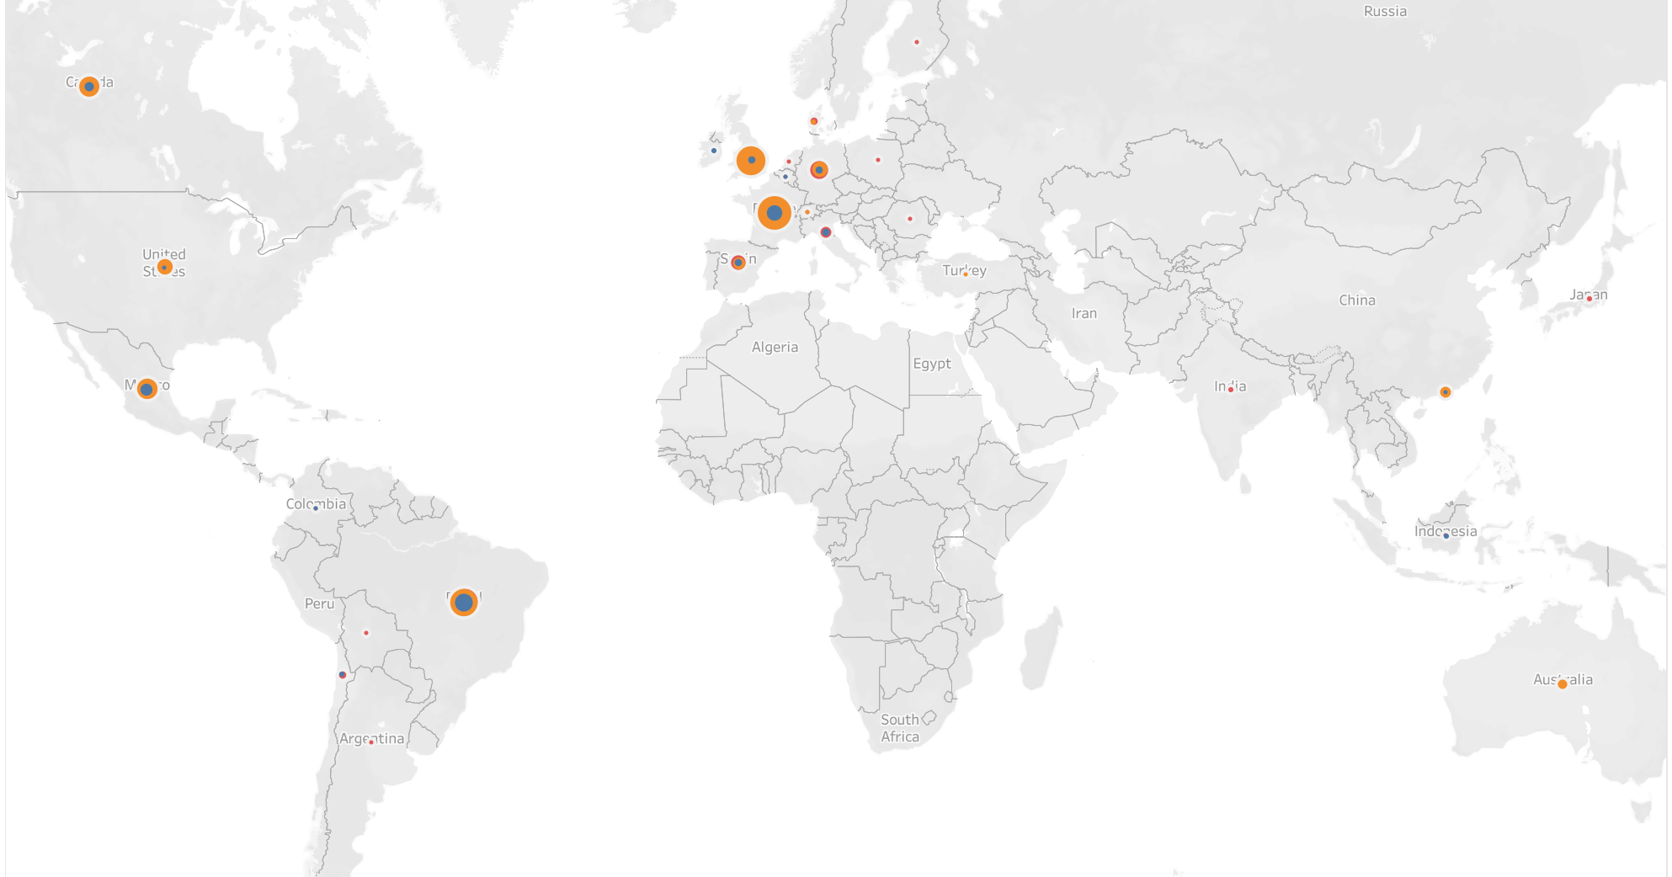
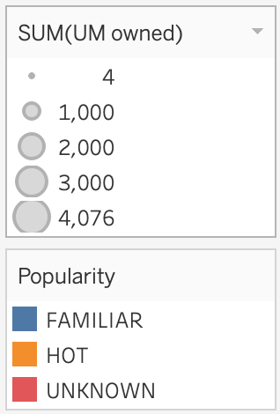
United Kingdom
Germany
France
Brazil

Slide 11

Recommendations
Sign more Latino singers or publish more Latino songs.
Identify the “sexy” style and give more focus on “sexy” songs.
Identify and publish more “summer hits” songs.
Survey female audience their favorite “sad” songs & singers. Analyze the songs and singers and refer to the results to publish relevant styled songs or to sign future singers.
Optimize the data of songs’ genres. Not enough data for now.
Explore reasons why UM owns the smallest number of shares in hot music among all popularity group (Playlist).
Analyze songs on Brazil, French, Mexico, and United Kingdom playlists, and refer to identified styles for future songs publication.

Slide 12
Thank You
Chan (Caiyi) Zhao
647 - 612 0137
caiyi.zhao@outlook.com

